Slide 1

IOWA NEPALESE ASSOCIATION
ANNUAL GENERAL MEETING
for
2018/2019
Presented by: INA Executive Committee - 2018/2019
Date: October 4, 2019

Slide 2
Timeline of Events:
नेपाली दशैं २०७५
New Year 2019
2018 Nov
2019 Jan
2018 Oct
2019 Jan
देउसी भैलो
Kali Prasad Baskota Live and Concert

Slide 3
Timeline of Events (contd.):
FLL Felicitation
VolleyBall
Blood Donation
2019 March
2019 April
2019 Feb
2019 Jan
2019 April
Table Tennis
नयाँ वर्ष २०७६

Slide 4
Timeline of Events (contd.):
Asian Festival
Summer Picnic
Jun 2019
August 2019
May 2019
2019 July
Dam to Dsm
Rudri puja

Slide 5
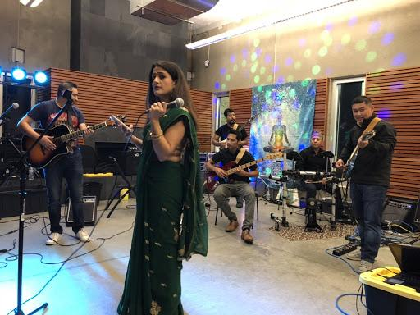
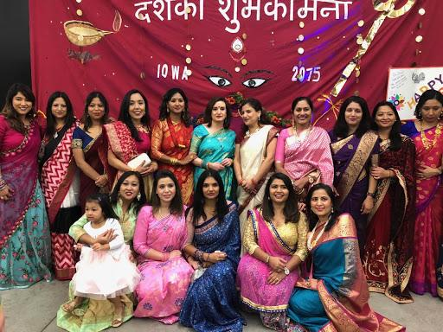
नेपाली दशैं २०75।
INA Dashain Event - 2018:
Summary:
Venue: Giovannetti Shelter, Walker Johnston Park
Date: October 28, 2018
As per evite record, 157 guests attended including kids.
Highlights: Dinner, singing, dancing, new board announcement and kids performances.

Slide 6
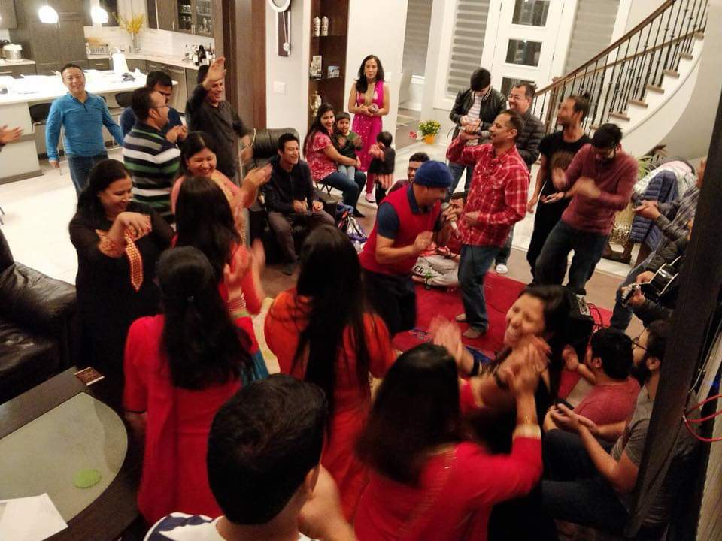
नेपाली दशैं २०75।
INA Deusi Bhailo - 2018
Summary:
INA kept Nepalese tradition alive regarding deusi and bhailo and celebrated in 3 days - 8th, 9th and 10th of November 2018.
There were huge participation from the community and we had 4 hosts and multiple co-hosts.
Kids and Adults participated with lots of zeal and enthusiasm and celebrated with festive spirit.

Slide 7
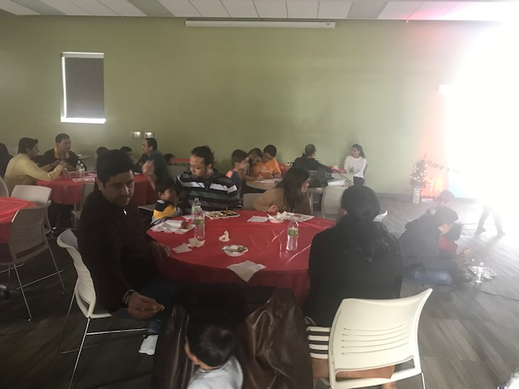
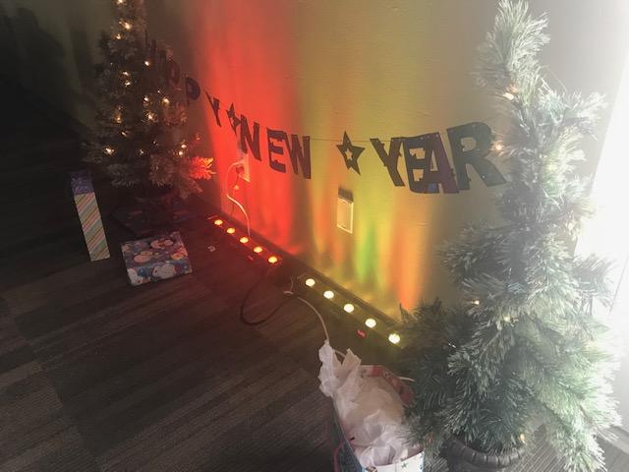
नेपाली दशैं २०75।
New Year Social - 2019
Summary:
INA planned meet & greet new year celebration lunch.
It was held on Waukee Community Center on January 1st.
It was an very informal event to start off new year with our community members.
Kids Gift exchange and door prizes were the highlights.

Slide 8
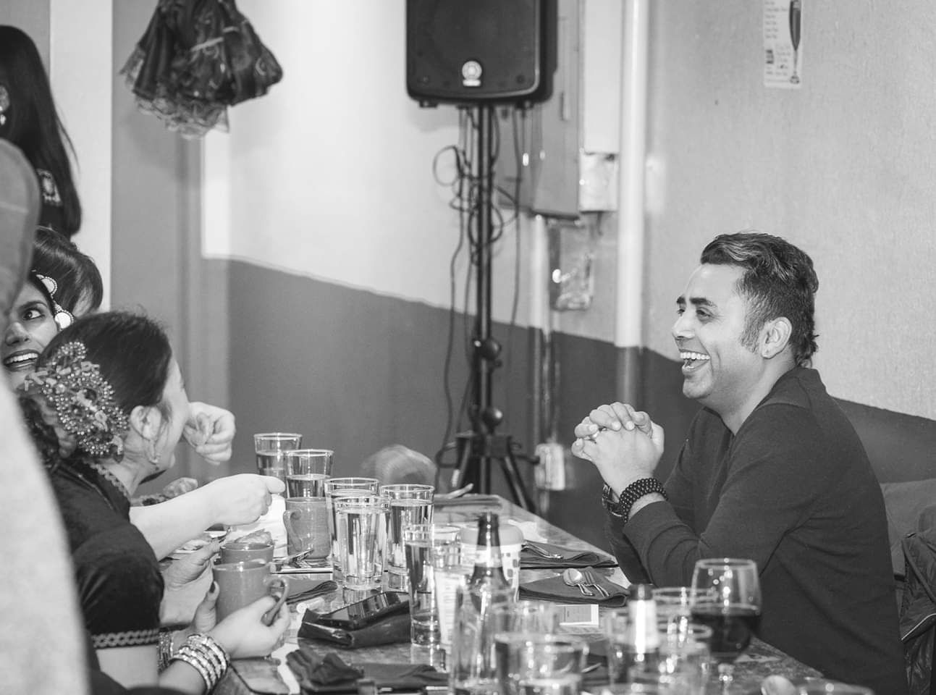
नेपाली दशैं २०75।
Kali Prasad Baskota, Live !!
Summary:
INA put together a nice musical event “Kali Prasad Baskota - Live in Concert” during January 2019 .
It was held on Grimes Community Center on January 27th.
The total attendance during the event was around 150.
INA got very good feedback regarding the show.

Slide 9
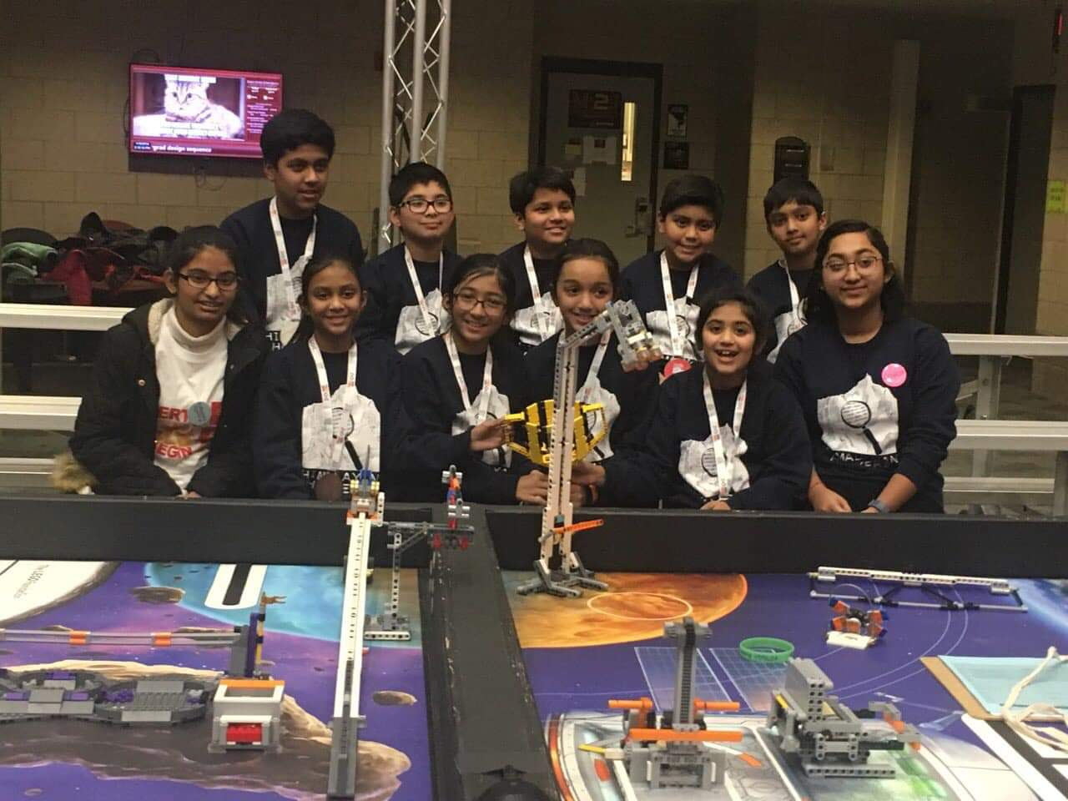
नेपाली दशैं २०75।
Himalayan Hackers Felicitation
Summary:
INA organized an event to congratulate, encourage and motivate the Team Himalayan Hackers as they were preparing for the world level competition.
Personalities/prospective supporters for Himalayan Hackers from different Nepalese organizations were invited to the event.
There were participation from NRNA NCC candidates and officials.
There was potluck dinner.

Slide 10
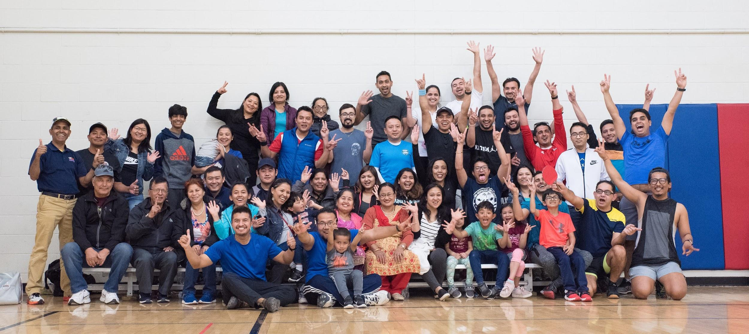
4th All Nepalese INA Table Tennis Tournament
Summary:
League matches were held at host’s houses/basements.
Tournament matches for Men's, Women's and Junior Category were held at Four Mile Community Center on April 6th, 2018.
Trophies were awarded during Nepali New Year Celebration Event.

Slide 11
नेपाली दशैं २०75।
Nepalese New Year 2076 celebration
Summary:
INA hosted Blood drive and Nepalese New Year's Eve 2076 with a celebration party.
Attractions of the events were - Gifts, Games, Music, Dance etc.
It was held at Grimes Community Center on April 13th.
Around 120 guests including kids attended the event.

Slide 12
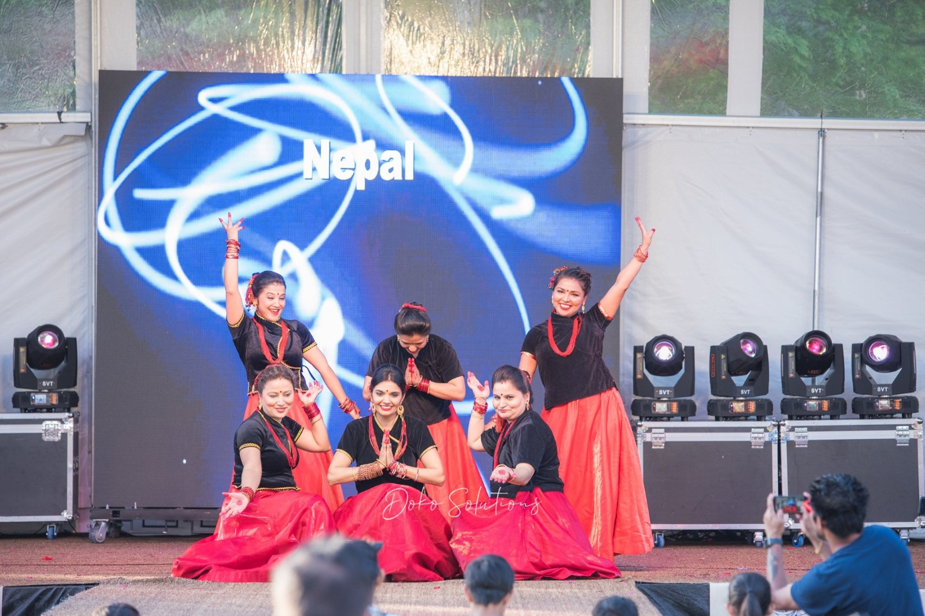
नेपाली दशैं २०75।
IAA Celebrasian 2019
Summary:
As usual, INA participated during IAA Celebrasian / Asian Festival 2019.
Our village was led by - Dipson Baskota(Village), Shweta Gyawali(Dance/Fashion), Avishek Sapkota(Food), Ananta Acharya(Operation), Suraj Amatya(Cultural)
Nepalese village participated in dance, fashion show, cultural tent food tent, food demo.
Nepalese village got the second place award this year.

Slide 13
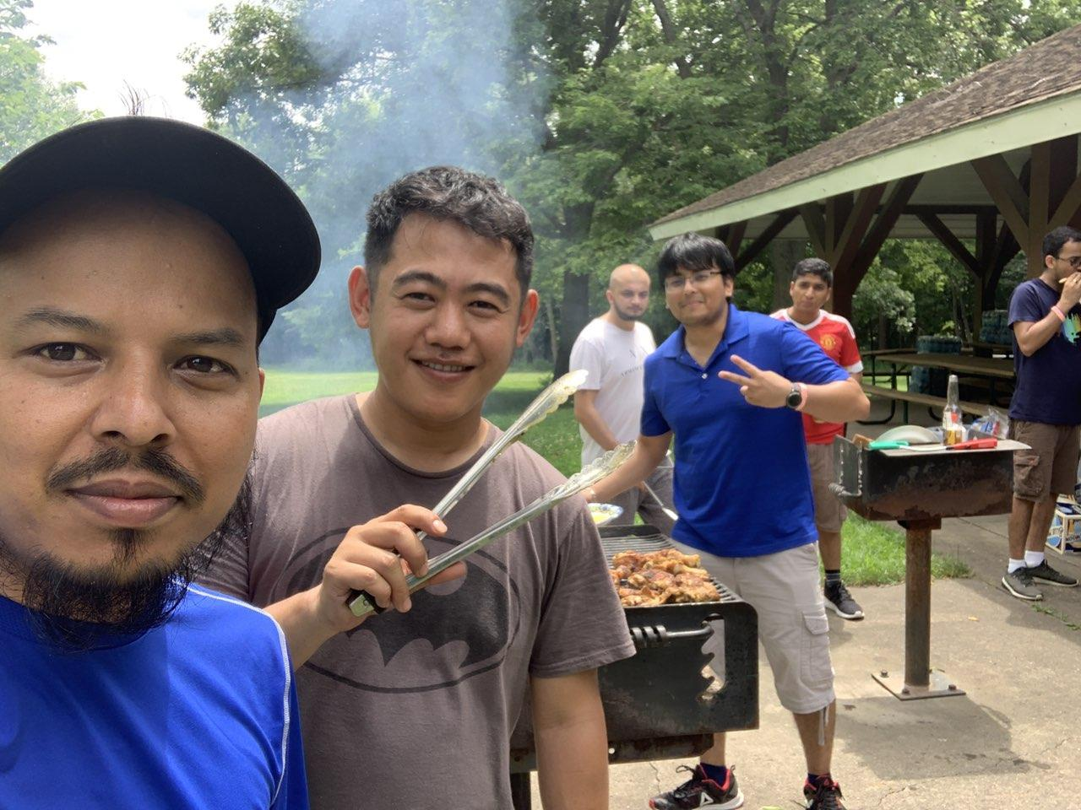
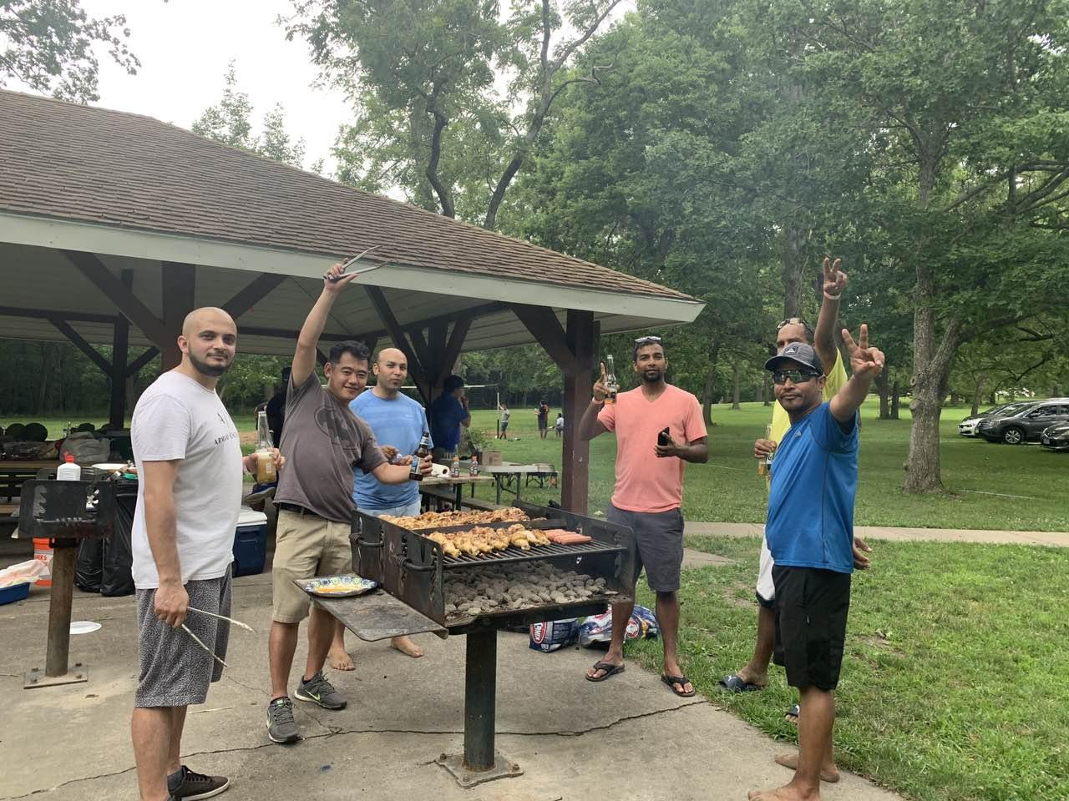
नेपाली दशैं २०75।
Summer Picnic 2019
Summary:
INA organized a fun filled picnic event has been scheduled on July 20, 2019 at Shelter# 3, Jester Park, Granger, IA.
BBQ, Games, Foods and Drinks were main activities.
The event help bring together the community and recognize everyone's contribution towards the success of Nepalese village at Asian festival.
Around 125 guests(including kids) attended and very nominal entry fee was collected.

Slide 14
More Events from 2019
Listings:
Interstate Volleyball Tournament
Semi-Annual INA Blood Drives
Meal to Heartland - Volunteer to Food Packaging
Dam to DSM Run
Rudri Puja
Nepali Classes
FLL Robotics Classes
Townhall for Earthquake Fund Disbursement
Himalayan Hackers World Championship
(..may be we missed some on the list)

Slide 15
Financial Summary Of Events 2019
S.No. | Event Name | Date | Cash In | Cash out | Remarks
1 | INA Dashain 2018 | Oct 2018 | 2760.00 | 2541.25 | +218.75
2 | Deusi Bhailo 2018 | Nov 2018 | 1156.00 | 1000.00 (support for volleyball tournament) | +156.00
3 | New Year 2019 | Jan 2019 | 380.00 | 243.44 | +136,56
4 | Kali Prasad Live | Jan 2018 | 2846.00 | 1831.54 | +1014.46
5 | FLL Felicitation | Feb 2019 | - | 493.01 | -493.01

Slide 16
Financial Summary Of Events 2019
S.No. | Event Name | Date | Cash In | Cash out | Remarks
6 | Nepali New Year 2075 | April 2019 | 1755 | 2166.84 | -411.84
7 | Asian Festival | May 2019 | 7888 | 4828.64 | 3059.36
8 | Summer Picnic | July 2019 | 550 | 1243.78 | -693.78
9 | Table tennis | March 2019 | 1341.38 | 1230 | -111.38 (Difference paid by INA)
10 | EarthQuake | August 2019 |  | 20244.36 | 998.60 (Balance in earthquake fund)

Slide 17
Financial Summary Of Events 2019
S.No. | Event Name | Date | Cash In | Cash out | Remarks
11 | First World Championship | April, 2019 | 15701.80 | 10541.44 | 5160.36
12 | Storage | Aug, 2019 | 100 | 927.72 | -827.72
13 | INA Membership | 2019 | 375 |  | +375

Slide 18
Financial Summary Of 2018-2019
S.No. | Accounts | Opening Balance | Closing Balance | Remarks
1 | Paypal | 470.82 | 2432.11
2 | Business Checking A/C | 6837.50 | 16062.71
3 | Business Market A/C | 975.44 | 1100.79
4 | Business Checking A/C (Earthquake) | 21252.96 | 998.60

Slide 19




Slide 20
